Slide 1


Bike Valuations at
By Beau Bellamy
31/7/19

Slide 2




Bio
Data Scientist – Lynxx (June 2019)
I help organisations across a range of industries solve the complex problems with the power of data
Data Analyst – ARTC (5 years)
Developed tools to enhance the analytical ability of the company and produce capacity models
Masters Astrophysicists – Sydney Uni (3 years)
Produced original research to identify over 40 new members of two stellar clusters, allowing for more information to be fed into stellar evolution modelling.

Slide 3
Agenda
Sell More Bikes
Context
Data Analysis and Design
Data
Insight
Iterative Modelling
95% accuracy
Deployment
Validation (A-B testing)

Slide 4
The Opportunity
Business:
“How can you sell more bikes.”
Data:
“Can we provide a valuation of a bike to provide users confidence and allow a more informed decision.”

Slide 5
Valuation model will increase revenue by $1.4M + per year
Improved Buyer experience
Estimating an additional 10,000 bikes purchased from the site.
Improved Seller experience
Estimate Dealers currently advertise 50% of stock, this will increase to 75%
Notes:
Buyers: additional $125,000
Sellers: $1.312 M

Slide 6
Data
There are about 18,000 bikes for sale on bikesale.com.au at any one time.
I created a automated script to collect all available information for each bike on bikesale.com. This script was executed weekly for the last 2 months.
I filtered this down to road bikes that I am interested in (4000).

Slide 7
Data Cleaning
Using domain knowledge and researching technical terminology, I was able to reduce the variability of highly variable features.
I removed features that had significant amount of null values

Slide 8
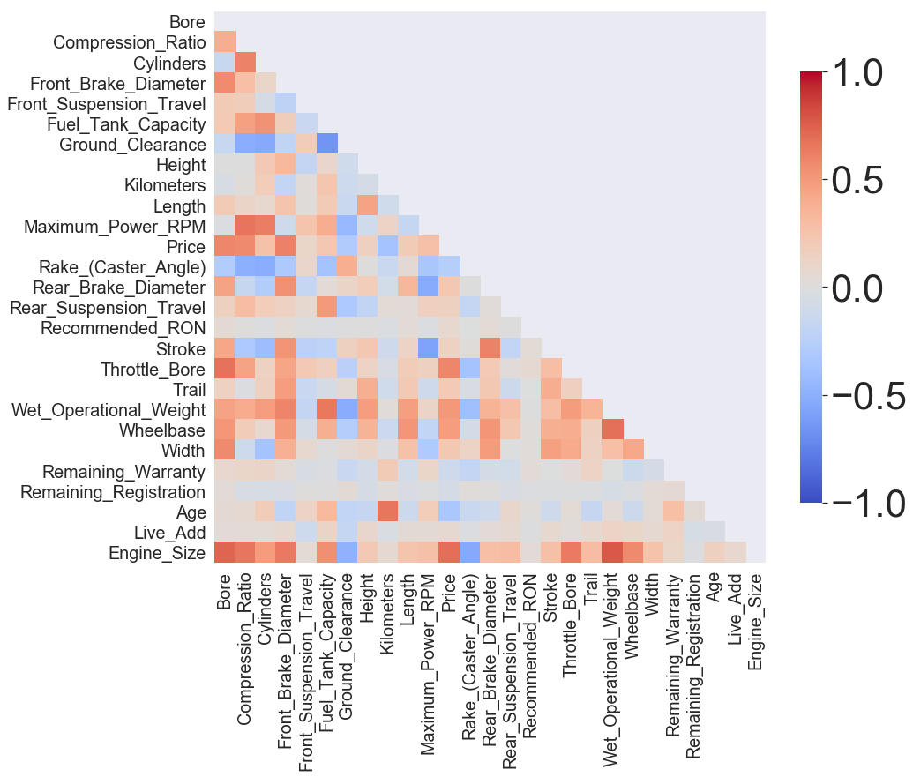
Data Cleaning
Used correlation to identify any features that had high collinearity.

Slide 9
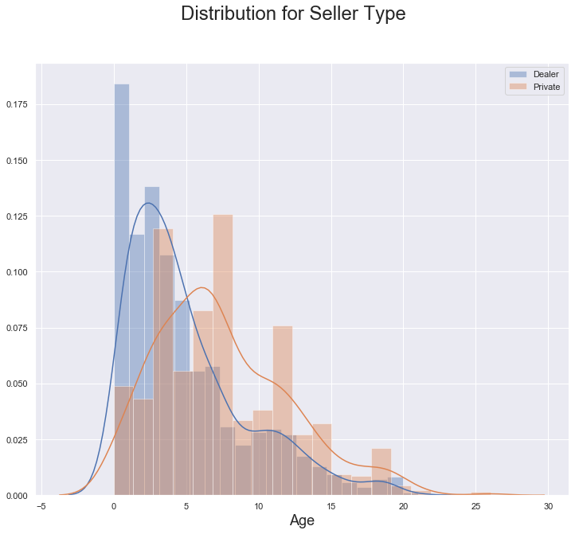
Age
Dealers tend to have newer bikes
Notes:
Start with explaining dealer=private distribution

Slide 10
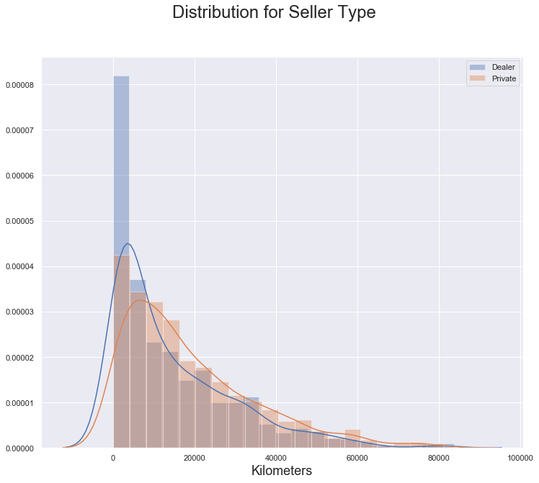
Kilometres
Similar distribution of bikes between dealers and private sellers.

Slide 11
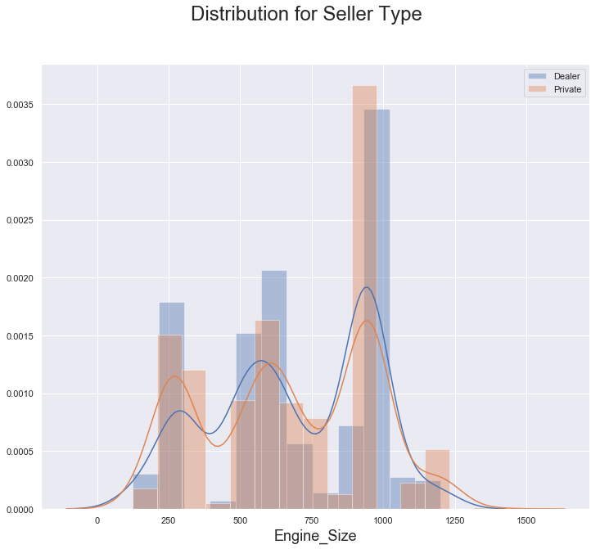
Engine Size
Engine capacity seems to be evenly distributed amongst private sellers and dealers

Slide 12
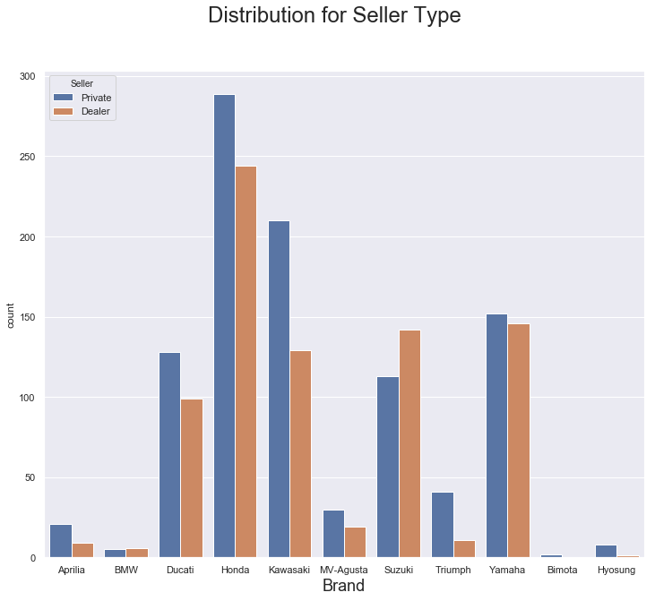
Brands
Dealers and private sellers have a similar distribution of all brands.

Slide 13
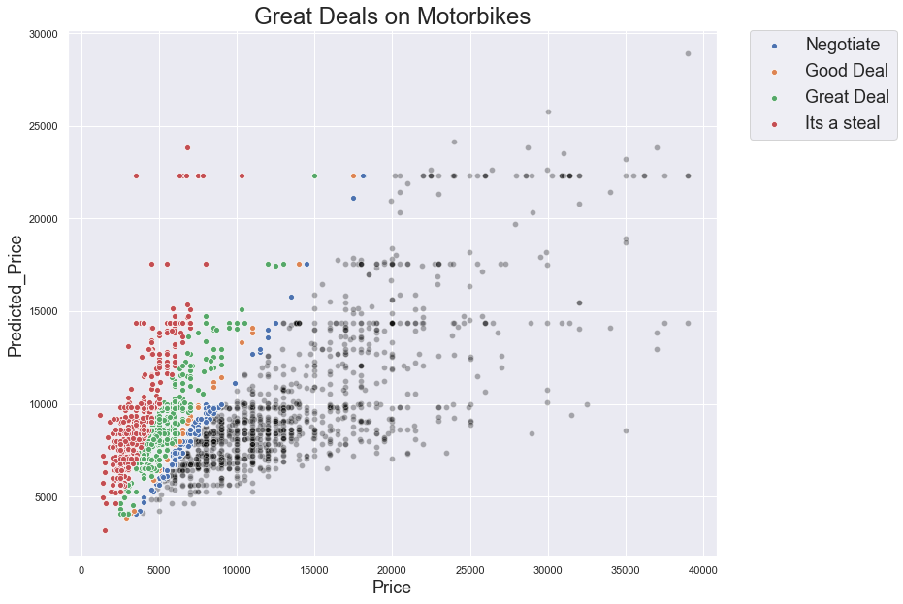
Naive Model
37% accuracy
Notes:
Negotiate: 90%
Good Deal: 80%
Great deal: 75%
It’s a Steal: 50%

Slide 14
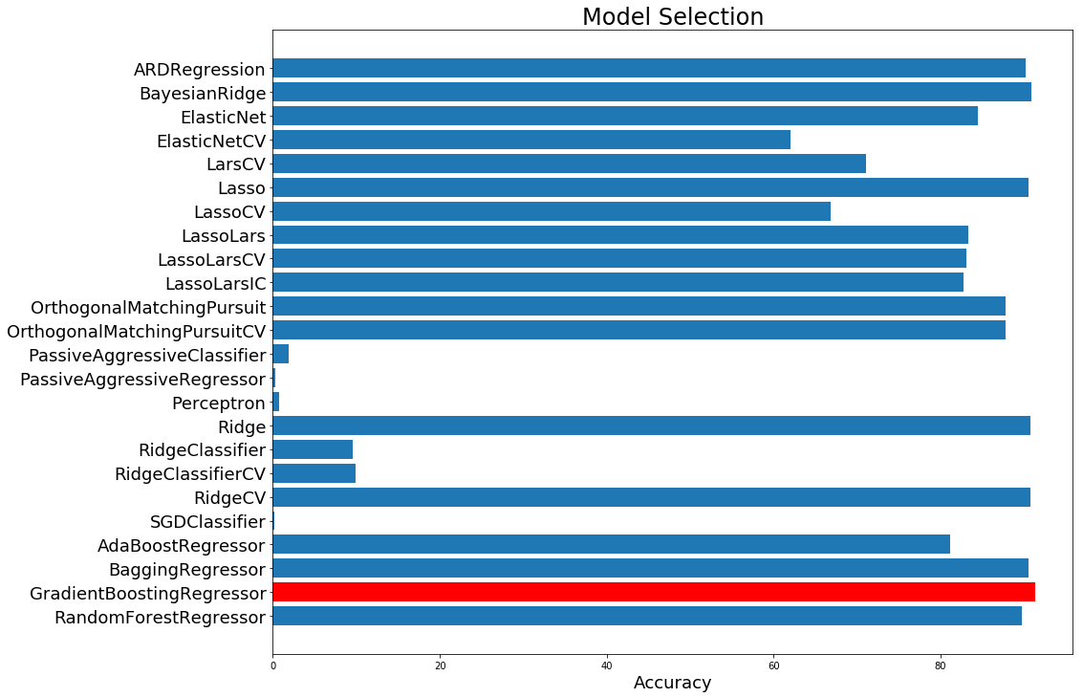
Models Selection

Slide 15
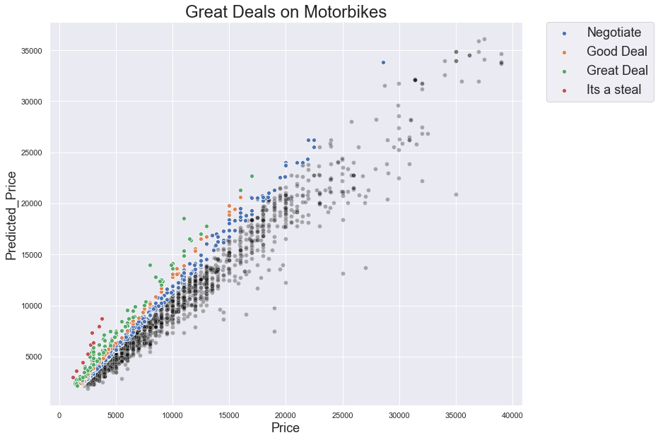
Best Model
90% Accuracy

Slide 16
Inferred Dealer Model

Slide 17

Inferred Dealer Model
95 % accuracy

Slide 18
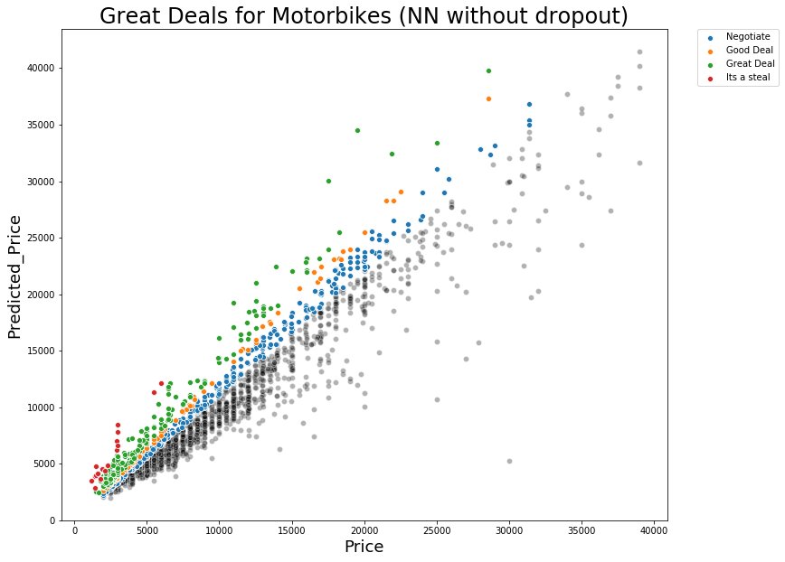
Deep Learning
95 % accuracy

Slide 19
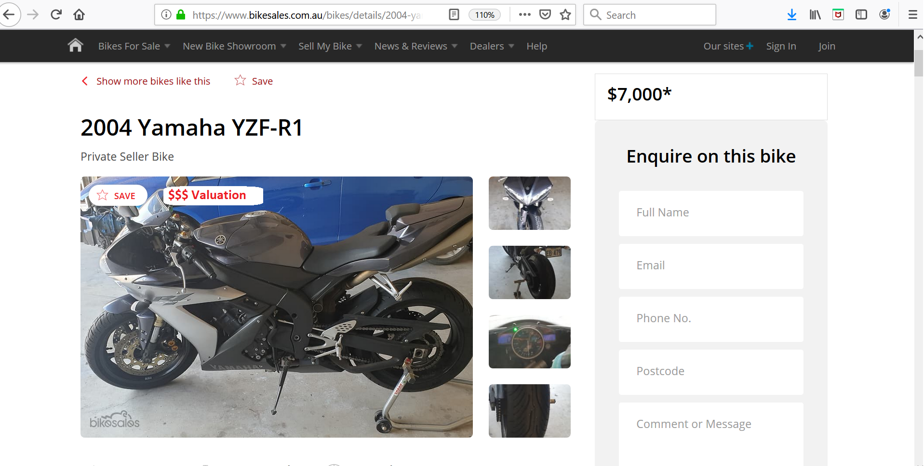
Deployment
Notes:
Value $14,827
https://www.bikesales.com.au/bikes/details/2004-yamaha-yzf-r1/SSE-AD-6044780/?Cr=21

Slide 20
Deployment
$14,827 – It’s a Steal
Notes:
Value $14,827
https://www.bikesales.com.au/bikes/details/2004-yamaha-yzf-r1/SSE-AD-6044780/?Cr=21

Slide 21
Validation
We can further validate the results of the model by conducting professional valuations on a random subset of the results.
We can deploy the model to a subset of users and perform an A/B test to verify the size and effect of the bike valuation.

Slide 22
Conclusion
Our economic modelling indicates a yearly revenue of $5M+
We can provide an accurate valuation for a motorbike
This will increase revenue by $1.4M + per year
Validation can be accomplished using A/B testing.
Can be applied to a larger part of your network

Slide 23

Applicable to your entire Network
https://www.bikesales.com.au/info/network-directory

Slide 24
Supporting Documents
Automated data acquisition
https://github.com/beaubellamy/BikeSales/bikeSales.py
GitHub: (https://github.com/beaubellamy/Data-Science-Course/tree/master/Capstone%20Project)
01 Capstone Project - Cleaning.ipynb
02 Capstone Project - Feature Engineering.ipynb
03 Capstone Project - Feature Selection.ipynb
04 Capstone Project - Modelling.ipynb
Project documentation.docx

Slide 25
Thank you

Slide 26
Extra slides

Slide 27
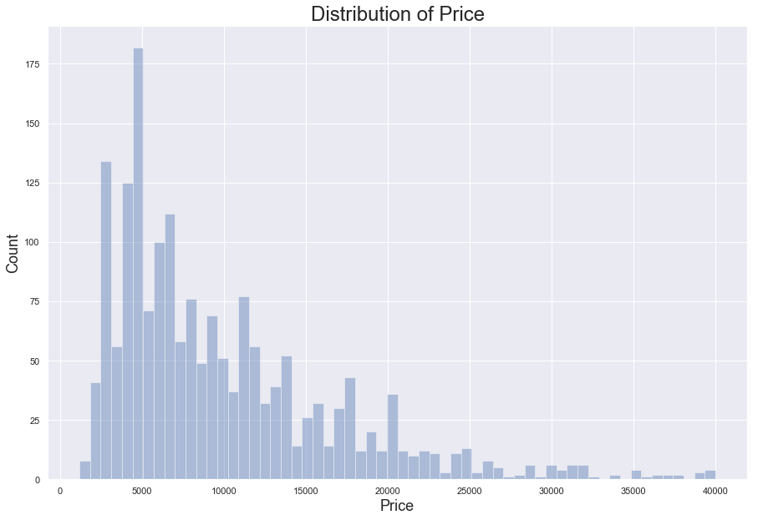
Price Distribution
Average $9900 ± $320
Notes:
By showing buyers that they can save money, you can increase the number of bikes for sale from dealers.

Slide 28

Process CRISP-DM
Notes:
Cross-Industry Standard Processing for Data Mining
Industry standard

Slide 29
BQ: Can we sell more bikes
DQ: Can we provide an accurate valuation of a bike
Data Cleaning
Data Processing
Feature Engineering
Model Selection and evaluation
Model Optimisation
Deployment

Slide 30
Current Revenue Stream
Sell 100,000 bikes per year
Seller
Purchase advertising space to sell the bike
$5.2 M
Ultimate
$225
10%
Premium
$130
20%
Standard
$75
70%

Slide 31
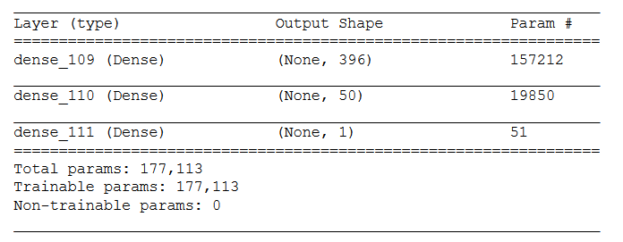
Neural Network Architecture

Slide 32
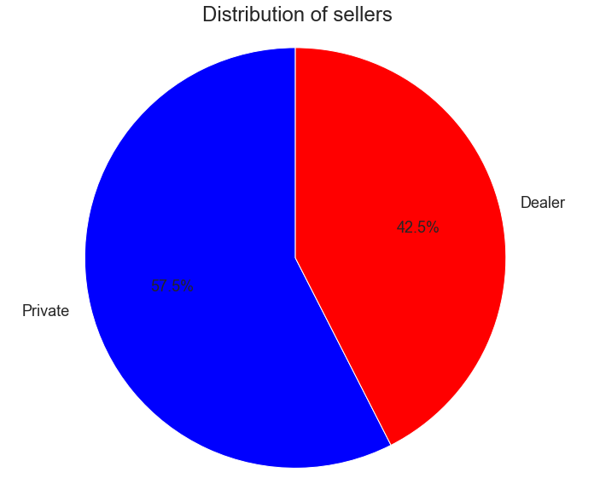
Seller Distribution

